Slide 1


Full Stack-Web Development - CSS

Slide 2

CSS Intro
3 Ways of Declaration
Inline -> As style attribute
Internal -> As style tag
External -> As separate file
Inline css : property
key : value pair is used.
e.g color:violet, border:2px solid red

Slide 3
CSS Intro
Internal css
made with tag inside head tag
p{
key:value;
}
eg. backgroud-color: aquamarine;
text-decoration:underline;

Slide 4
CSS Intro
External css
New file made with link inside head tag
Tag : link
Attribute: rel-> relation
p{
key:value;
}
eg. backgroud-color: cornflower;
text-decoration:line-through;

Slide 5
CSS Intro
I
Specificity
Inline>Internal>External
Selectors
Basic Selectors
Advance Selectors

Slide 6
I
Basic Selectors (categorize to 5 types)
Element selectors (eg. p,div,h1)
Id Selectors (eg. Id=“name” ->
#name{
background-color:purple;
}
Note: Do not repeat id name

Slide 7
I
Basic Selectors (categorize to 5 types)
iii. Class Selectors(eg. Class=“className”->
.className{
border:2px solid orange;
}
Note: We can repeat class names

Slide 8
I
iv. Attribute Selectors
eg.href=“www.google.com”->
a[href=“www.google.com”]{
font-size:200px;
}
eg. <input type=“text”>->
input[type=“text”]{
border:2px dashed red;
}

Slide 9
I
Universal Selector
*{
border:2px solid yellow;
}
Note: It selects everything
Specificity:
Inline>id>class>element

Slide 10
I
Advance Selectors (categorize to 4 types)
Combinators
Pseudo Classes
Structural Pseudo classes
String Matching

Slide 11
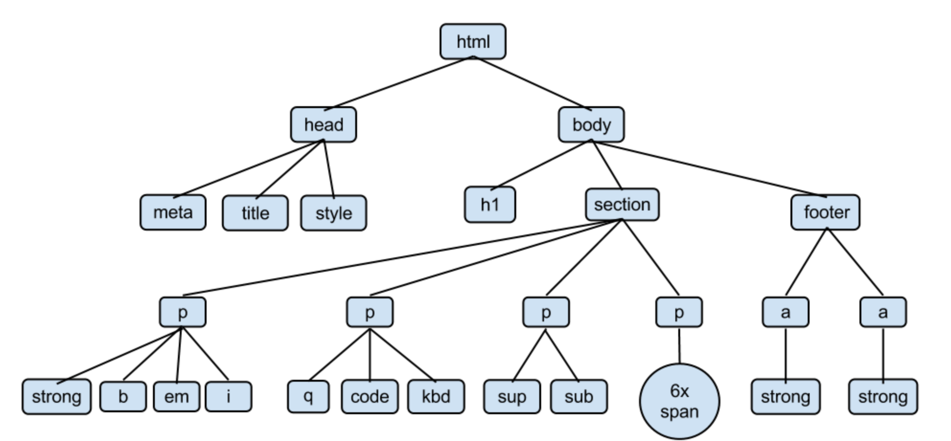
I
HTML is the root element
Here,
->p tags are the descendent of
Body.
->And sibling among themselves.
->strong,b,em are also descendants
of body.
->strong,code,sup,sub are general
siblings.

Slide 12
I
Advance Selectors
Combinators : Combination of 2 things
i. Descendants
-> a ‘space’ in between them means a descendent.
-> it works on any level.
ii. Child
-> we have to use ‘>’ to denote child selector.
-> it do not work on all level.

Slide 13
I
Combinators
iii. Adjacent Sibling
-> it is denoted via ‘+’
-> only one tag is selected that comes after element.
iv. General Sibling
-> it is denoted via ‘~’(Tilde)
-> all the tag is selected that comes after element.

Slide 14
I
Advance Selectors
Pseudo Classes
:hover
:active
:visited
:nth of the type(odd,even)
:first-child,:last-child
:focus

Slide 15
I
nth of the type
:nth-of-type(an+b)
an+b->cycle formula
an-> intervals
b-> offset

Slide 16
Pseudo Elements
A CSS pseudo-element is used to style specified parts of an element.
-> It doesn’t work on inline elements.
p::first-letter
p::first-line
::after (don’t affect inline elements)
::before
Css-property : content: ‘\1F4F1’ (CSS Unicode)

Slide 17
String Matching
1.Starts with : ^=
Eg. a[href ^= “https”]
2.Ends with : $=
Eg. a[href $= “com”]
3.Present anywhere : *=
Eg. a[href *= “google”]

Slide 18
Inheritance
Child adapt properties of parents.
Works on : color, font-size, background-color
Doesn’t works on : border
Colors
Primary Colors : R G B
How many colors are there?
R G B takes -> 1byte ->8bits
Thus we have => 2⁸ * 2⁸ * 2⁸ = 16Million Colors

Slide 19
Colors
Ways of Declaration of colors
Hexadecimal: R G B #(0-f, 0-f) ,(0-f ,0-f) ,(0-f ,0-f)
RGB : rgb(0-255, 0-255, 0-255)
RGBA : rgba(0-255, 0-255, 0-255 , 0-1)
Explore more colors scheme for your projects.

Slide 20
Box Model
It treats every element as a rectangular box.
Properties of box model:
1.Dimension (height & width in 2d)
2.Border (dashed, dotted and solid)
3.Margin
4.Padding

Slide 21
Margin
Space between 2 elements.
Margin-top
Margin-right
Margin-left
Margin-bottom
Shorthand: Top right bottom left (in clockwise direction)
Top-bottom right-left
Top right-left bottom

Slide 22
Padding
Space inside the selected element.
Padding-top
Padding-right
Padding-left
Padding-bottom
Shorthand: Top right bottom left (in clockwise direction)
Top-bottom right-left
Top right-left bottom
Note : These works properly only on block element.

Slide 23
CSS Units
It is ways of measurement
2 types are present
1.Absolute : These are fixed and don’t show responsiveness.
2.Relative : %, em, rem, vh , vw
Absolute way
1. px : most commonly used.
2. cm , mm and inch : these are only used in big screens and posters.

Slide 24
CSS Units
Relative way
% : relative to its parent.
2. em : it is also relative to its lexical parent and inherit their properties.
Due to this it shows ‘Snowball effect’.
3. rem : it is relative to it’s root and inherit their properties.
Due to this it avoids ‘Snowball effect’.
4.vh : view-height and vw : view-width (here view stands for viewport.

Slide 25
Box Model (Display)
Display : Block -> It works on Box Model.
Display : Inline -> Doesn’t works on Box Model.
Display : Inline-block -> to make box model work on element showing inline elements we use .
Display : none-> Items become invisible and it won’t take any space.
Visibility: hidden -> Items become invisible and it won’t take any space.

Slide 26
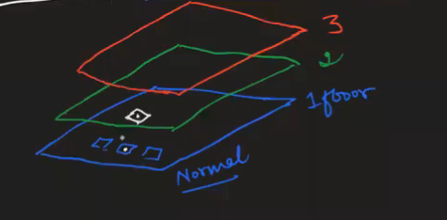
Positions
We have 4 offsets top bottom left right.
There are 5 properties positions present:
1.static: It doesn’t leave it’s normal flow.
2.relative: It changes it’s position with respect to its previous position.
3.absolute: It comes out of its normal flow
and it changes position with
respect to most recent positioned
parent.

Slide 27
Positions
There are 5 properties positions present:
4.Fixed: i. Aligned itself to respect of the body.
ii. It will take the offset and not move from their.
iii.It is not dependent on parent element.
iv. Can use any position except static.
5.Sticky : i. Mixture of 2 positions -> relative and fixed
ii. It depend on parent’s height.
iii. It will offset acc. to your viewport.

Slide 28
Task : Make a navbar
Do it yourself
Solution:
Make a list of elements and make it horizontal.
Put it inside nav tag and put nav tag inside section tag
Now section tag is the parent so we can use sticky in nav tag and give offsets to make it work.
Style for better results.

Slide 29
Font
Properties:
1.font-family-> serif, san-serif, cursive, monospace, fantasy
2. font-size-> any size (css units)
3. font-weight -> (range -> 100 – 900)
4. font-style -> italic
5. line-height -> any size (css units)
6. letter-spacing -> any size (css units)

Slide 30
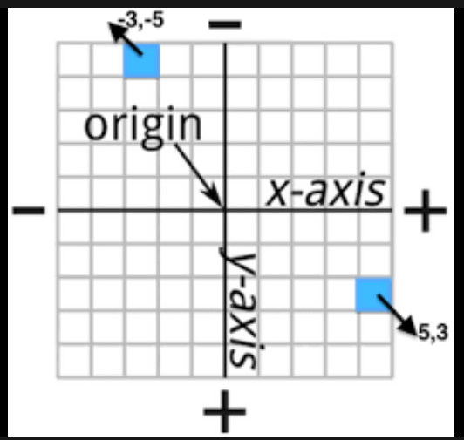
Text Shadow
text-shadow: x y sharpness color
->We can use multiple shadows to make a chain.
Box Shadow
box-shadow: x y sharpness color
Same properties of text shadow can be applied here.

Slide 31
List Properties
list-style-type: circle, square,(also css-unicode)
list-style-position: inside/outside
Shorthand
list-style: list-style-type list-style-position

Slide 32
Overflow properties
1.white-space: wrap/nowrap
2.overflow: hidden/scroll
3.text-overflow: clip/ellipsis;
To make it look better, use
‘overflow : scroll and text-overflow: ellipsis;’
only in hover.
max-width: If viewport crosses that limit it shrinks the element.
min-width: After this limit the element can overflow.

Slide 33
Clear And Float
Also used to get out of normal flow.
Float : Gets out of the normal flow and places itself w.r.t it’s given direction. (left /right).
Clear : It clears the direction set by the float (left/right).
Task: Make a newspaper article (try it yourself).

Slide 34
Background Images
1.background-image: url(‘--any-image--’);
2.background-repeat: no-repeat
3.background-size: cover/contain
4.background-position: center/right/left
5.opacity: (0-1 range)
6.filter: grayscale (0%-100%)

Slide 35
Flex
1.background-image: url(‘--any-image--’);
2.background-repeat: no-repeat
3.background-size: cover/contain
4.background-position: center/right/left
5.opacity: (0-1 range)
6.filter: grayscale (0%-100%)

